Slide 1
CHAPTER 8: CPU and Memory
Design, Enhancement, and Implementation
The Architecture of Computer Hardware, Systems Software & Networking:
An Information Technology Approach
4th Edition, Irv Englander
John Wiley and Sons ©2010
Notes:
Chapter 6 - The LMC can do quite a lot even with 10 instructions in its instruction set. You could perform basic arithmetic operations, compare numbers, execute instructions in sequence as well as implement conditions and loops. Computers today are much more flexible and sophisticated.
Chapter 7 – We discussed the principal features of CPU and memory. We covered the basic architecture of the CPU, registers, instruction sets and formats, and the machine cycle: fetch and execute phase. We will revisit some of these topics in today’s in-class activity.
Chapter 8 discusses enhancements of the CPU and memory. The dilemma is how much details you as CIS students you really need to know about different memory and CPU designs, enhancements and implementation. I tried to simplify this chapter by including some materials from other sources.

Slide 2
Topics Discussed
Different CPU architectures
  Well-established
  Very recent: Transmeta VLIW and more recent: Intel EPIC
CPU features and enhancements for improving performance
  Timing issues
  Separate fetch and execute units
  Pipelining
Copyright 2010 John Wiley & Sons, Inc.
8-<number>
Notes:
Transmeta and Intel – the positive effect of the VLIW architecture has not really been fully tested.

Slide 3
Topics Discussed
CPU features and enhancements for improving performance
  Scalar and superscalar processor organization
    Out-of-order processing
    Branch instruction processing
Memory Enhancements
  Wide memory access path
  Memory interleaving
  Cache memory
Concept of multiprocessing
Copyright 2010 John Wiley & Sons, Inc.
8-<number>

Slide 4
Current CPU Architectures
Current CPU Architecture Designs
  Traditional modern architectures
  VLIW (Transmeta) – Very Long Instruction Word
  EPIC (Intel) – Explicitly Parallel Instruction Computer
Current CPU Architectures
  IBM Mainframe series
  Intel x86 family
  IBM POWER/PowerPC family
  Sun SPARC family
Copyright 2010 John Wiley & Sons, Inc.
8-<number>
Notes:
A CPU architecture is defined by the basic features of the CPU, i.e., the # and type of registers, methods of addressing memory, and basic design of the instruction set. Things such as implementation of instructions, instruction execution speed, or how the CPU is interfaced with other components of the computer are not included as these details are usually referred to as the computer’s organization.
There have been many CPU architectures proposed and implemented. However, very few survived the test of time. The IBM mainframe architecture – 40 years old. Each of the remaining three is about 20 years.
We also have two very recent ones. The basic goal of the 2 architectures (VLIW and EPIC) is to increase execution speed by processing instruction operations in parallel.

Slide 5
Early CPU Architectures: Problems and Solutions
Few general-purpose registers
Wide variety of addressing techniques
Large number of specialized instructions; many of them were rarely used but added hardware complexity and slowed down other instructions
Instruction words of varying sizes
Increase the # of general-purpose registers
  Improves data memory accesses
  reduces the number of addressing modes and simplifies architecture design
Reduce the instruction set repertoire
Introduce fixed-length, fixed format instruction words to allow instructions to be fetched and decoded independently and in parallel
Copyright 2010 John Wiley & Sons, Inc.
8-<number>
Notes:
Ad (3) - The vast majority of instructions executed on any processor are LOAD, STORE, etc.
Ad (4) - Intel x86 is a good example – instruction word formats: 1-15 bytes in length.
However, Sun SPARC: single addressing mode, all instructions are 4 bytes in length, and has 5 primary instruction formats.

Slide 6
VLIW Architecture
Transmeta Crusoe CPU
128-bit instruction bundle = molecule
  Four 32-bit atoms (atom = instruction)
  Parallel processing of 4 instructions
64 general purpose registers
Code morphing layer
  Translates and reorders instructions written for other CPUs into molecules
  Instructions are not written directly for the Crusoe CPU
  Implemented for the Pentium CPU family
Copyright 2010 John Wiley & Sons, Inc.
8-<number>
Notes:
VLIW – very long instruction word. The basic goal of this architecture is to increase execution speed by processing instruction operations in parallel. The problem is that many instructions are executed in the sequential order and data used by an instruction may depend on the result from a previous instruction. This situation is called as a data dependency. Also, branches and loops may alter the sequence, resulting in control dependency.

Slide 7
EPIC Architecture
Intel’s radical departure from a 32-bit architecture
An order of magnitude performance improvement
128-bit instruction bundle
  To increase parallelism
128 64-bit general purpose registers
128 82-bit floating point registers
Can address 16 exabytes (10¹⁸) of logical memory
Can address 8 exabytes of physical memory
Programmers and compilers follow guidelines to ensure parallel execution of instructions
Copyright 2010 John Wiley & Sons, Inc.
8-<number>
Notes:
EPIC – explicitly parallel instruction computer. Designed by Intel for its IA-64 processor family. The difference? VLIW – the code-morphing software, integral to the architecture, handles proper sequencing of instructions. EPIC – places the burden on the assembly language programmer or on the program compiler.

Slide 8
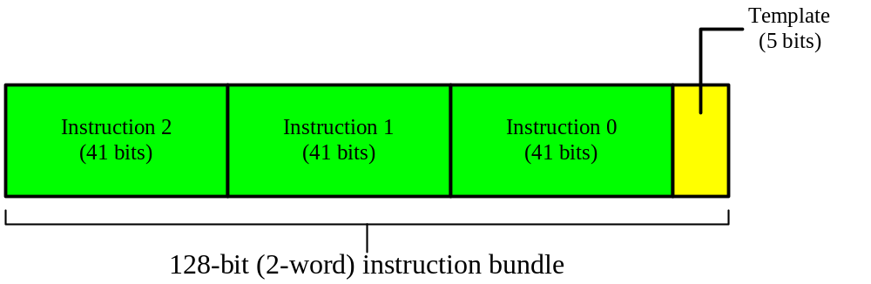
Figure 10.14 An Itanium instruction bundle.
Fetching 2-word instruction
  Three 41-bit instructions
  5-bit template tells the CPU how to handle the instructions
Compiler determines which instructions should share a bundle
If the instructions must be executed in sequence, the bundle holds one instruction
© 2005 Pearson Addison-Wesley. All rights reserved

Slide 9
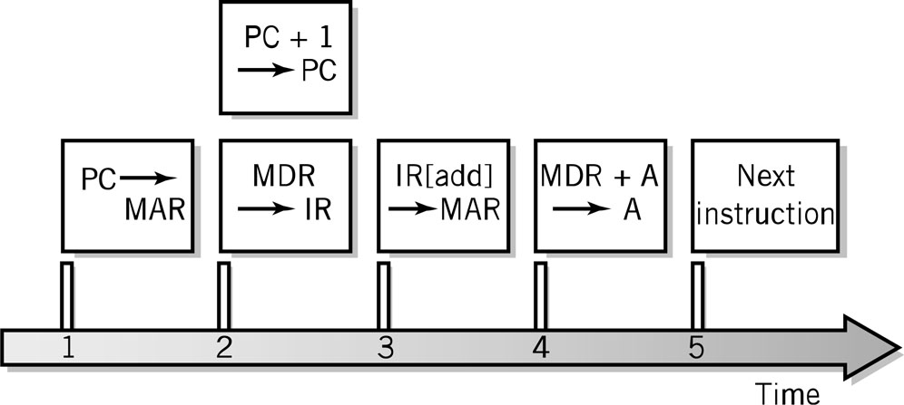
Fetch-Execute Cycle Timing Issues
Computer clock is used for timing purposes for each step of the instruction cycle
GHz (gighertz) – billion steps per second
Instructions can (and often) take more than one step
Data word width can require multiple steps
Fetch-execute timing diagram
Copyright 2010 John Wiley & Sons, Inc.
8-<number>
Notes:
Timing issues - It takes time to move instructions and data between registers and memory. Registers and memory operate with a slightly different speed. The clock controls and synchronizes each step in the instruction cycle. The pulses of the clock are separated sufficiently to assure that each step in the instruction cycle has time to complete. The data has to “settle down” in a register or memory before the next step can take place. Sometimes, if memory is slow and the clock is fast, memory cannot keep up with the clock, a wait state is introduced.
The diagram represents the ADD instruction. Normally, it takes 5 steps. PC was incremented in step 5. However, PC can be incremented earlier in step 2 during the fetch phase, in parallel with moving the instruction to IR. (Incrementing PC does not require memory access.) The number of steps is thus reduced to 4. If one performs addition using two registers (alone), the number if steps in the machine cycle is reduced to 3. See Figure 8.3, p. 248.
One of the factors that determine the speed of the computer is the frequency of the clock.
Early IBM PC - 4.77 MHz → 4.77 million pulses/second.
Today’s PCs – 3 GHz - have about 600 times faster clock.
Does it mean that a contemporary computer is only 600 times faster than the old one? NO!!! Modern computers may be even 5000 faster than their early predecessors. How does it happen? There are other factors that determine the speed of the computer. Not only the clock determines the speed, but the computer’s overall design. The speed also depends on other factors such as: (a) the width of the data word, (b) the width of data registers, (c) the width of memory locations, (d) memory access time - cache memories are used (several nanoseconds access time) need to be compatible with the clock speed, and (e) bus throughput rate & speed. There has to be a synergy between all the components

Slide 10
CPU Features and Enhancements
Separate Fetch/Execute Units
Pipelining
Multiple, Parallel Execution Units
Hyperthreading
Scalar Processing
Superscalar Processing
Branch Instruction Processing
Copyright 2010 John Wiley & Sons, Inc.
8-<number>

Slide 11
Separate Fetch-Execute Units
Fetch Unit
  Instruction fetch unit
  Instruction decode unit
    Determine opcode
    Identify type of instruction and operands
  Several instructions are fetched in parallel and held in a buffer until decoded and executed
  IP – Instruction Pointer register holds instruction location of current instruction being processed
Execute Unit
  Receives instructions from the decode unit
  Appropriate execution unit services the instruction
Copyright 2010 John Wiley & Sons, Inc.
8-<number>

Slide 12
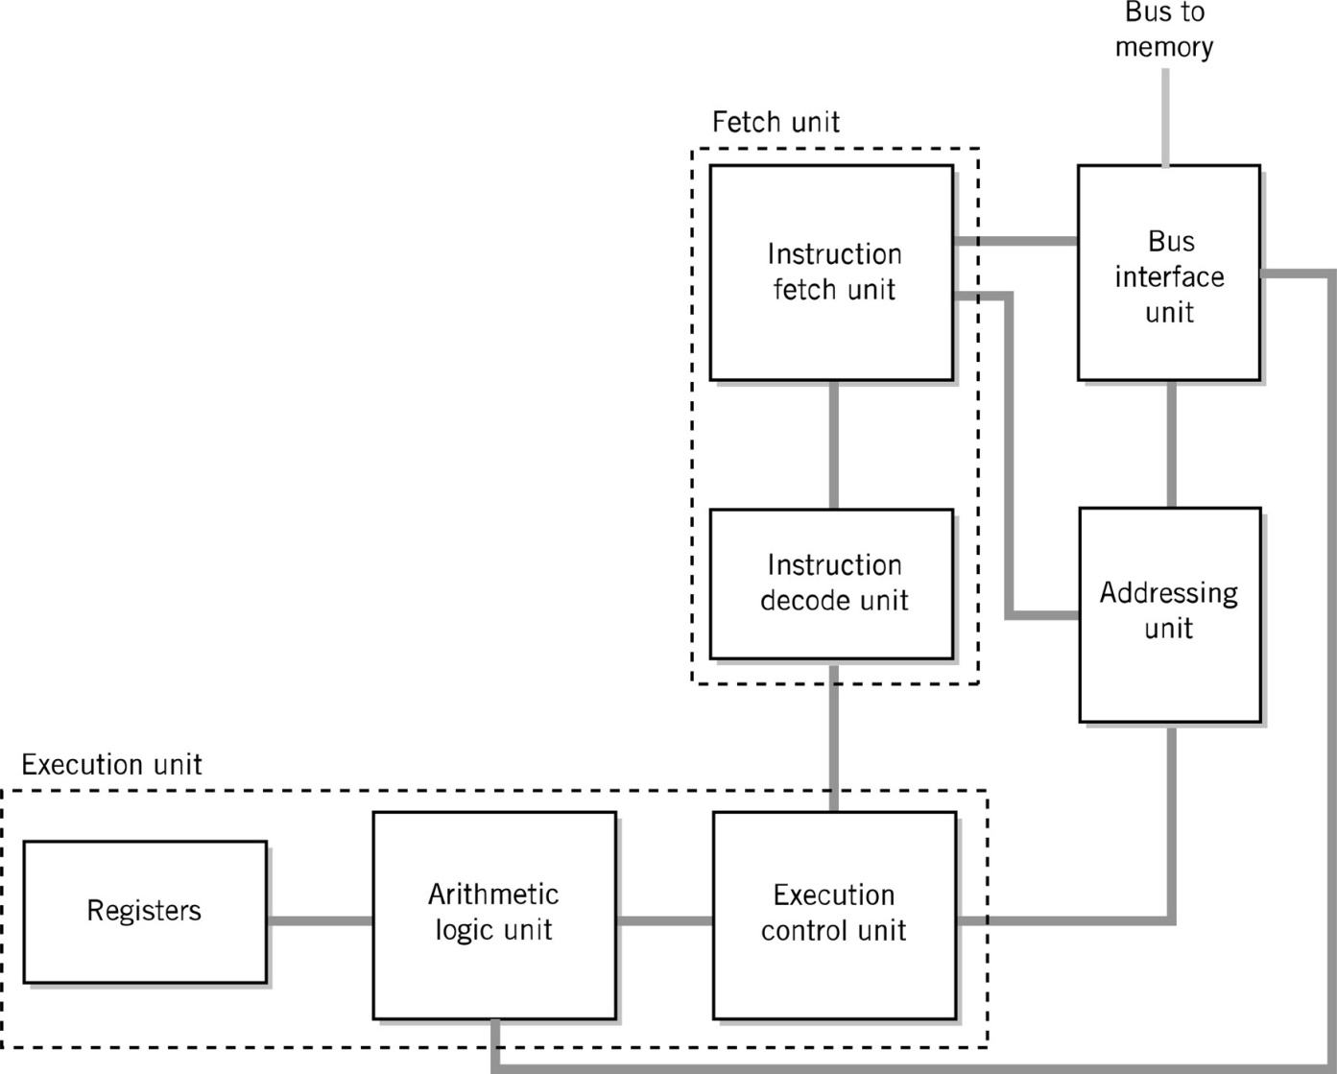
Alternative CPU Organization
Copyright 2010 John Wiley & Sons, Inc.
8-<number>

Slide 13
Instruction Pipelining
Assembly-line technique to allow overlapping between fetch-execute cycles of sequences of instructions
Non-pipelined processor
  Handles one instruction at a time
Pipelined processor
  Executes multiple instructions simultaneously
    Fetches the 1st instruction
    Then fetches the 2nd instruction while the 1st one is being decoded
  Increases the CPU’s output
© 2005 Pearson Addison-Wesley. All rights reserved
Notes:
Pipelining - While one instruction is executed, the next instruction is being fetched. The average # of instructions performed at a given time is increased.
Distinguish between pipelining and piping. The latter is the OS concept. Implemented by a “|” on the command line.
Linux: ls –al | more
The output from the ls command is used as the input to the more command

Slide 14
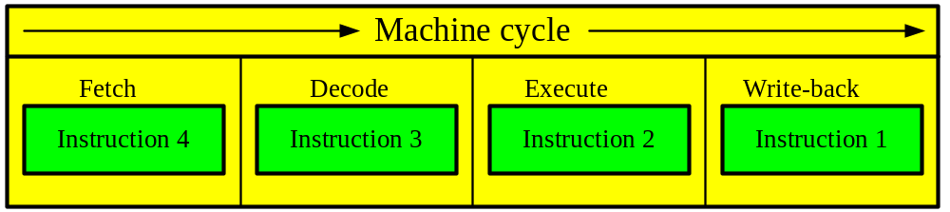
Instruction Pipelining
Machine cycle is broken into 4 discrete stages:
  Fetch – instruction is fetched
  Decode – instruction is decoded to micro-operations
  Execute – instruction is executed
  Write-back – results are written back to memory
© 2005 Pearson Addison-Wesley. All rights reserved

Slide 15
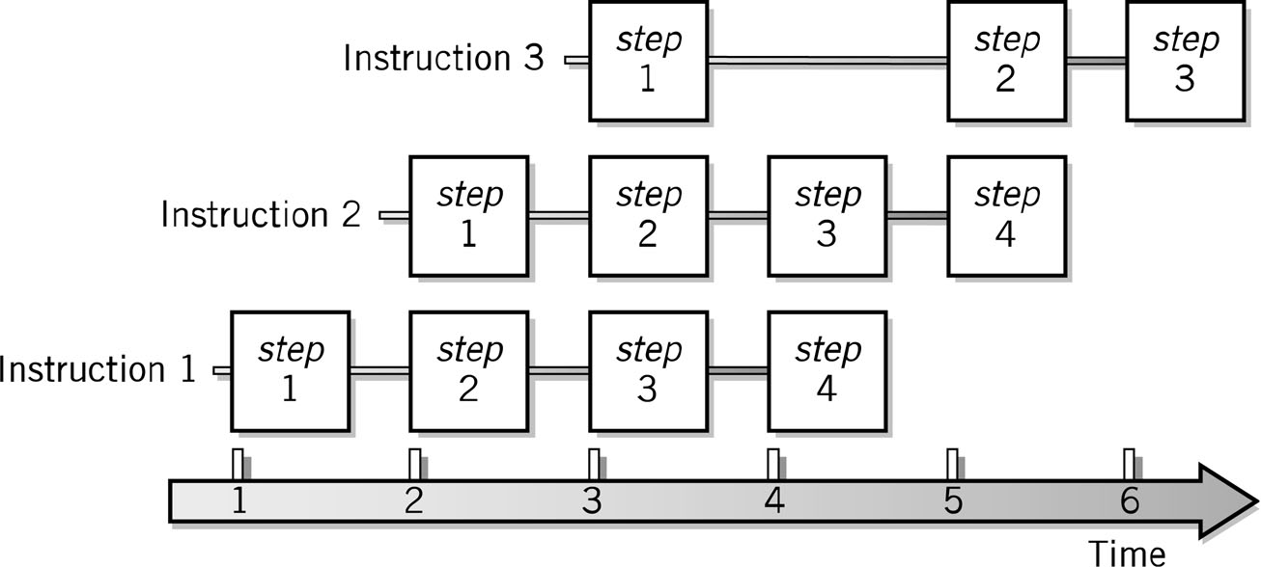
Pipelining Example
Copyright 2010 John Wiley & Sons, Inc.
8-<number>
Notes:
LOAD contains 4-5 cycles. You can have 4 other instructions started at various points of the LOAD cycle. Figure 8.5, p. 252. The F-E cycle for instruction 3 shows a delay between step 1 and step 2. Simply, step 2 in this instruction may need data from step 3 of instruction 2.

Slide 16
Problems with Pipelining
Stalling
  Instructions have different numbers of steps
    Branching – 3 steps
    Loading/Storing/Adding – 4 or 5 steps
    Adding integer numbers – less steps
    Adding floating point numbers – more steps
Branching
  Chiefly conditional branching
  May invalidate all the instructions in the pipeline, if branch is taken
Copyright 2010 John Wiley & Sons, Inc.
8-<number>

Slide 17
Improving performance
Scalar processing
  Uses one pipeline
  Average instruction execution is approximately equal to the clock speed of the CPU
Superscalar processing
  uses more than one pipeline
  Allows more than one instruction to be executed simultaneously
  Pentium chip can execute 3 instructions simultaneously
    Two integer pipelines
    One floating-point pipeline
    Each pipeline optimized for one type of instruction
© 2005 Pearson Addison-Wesley. All rights reserved

Slide 18
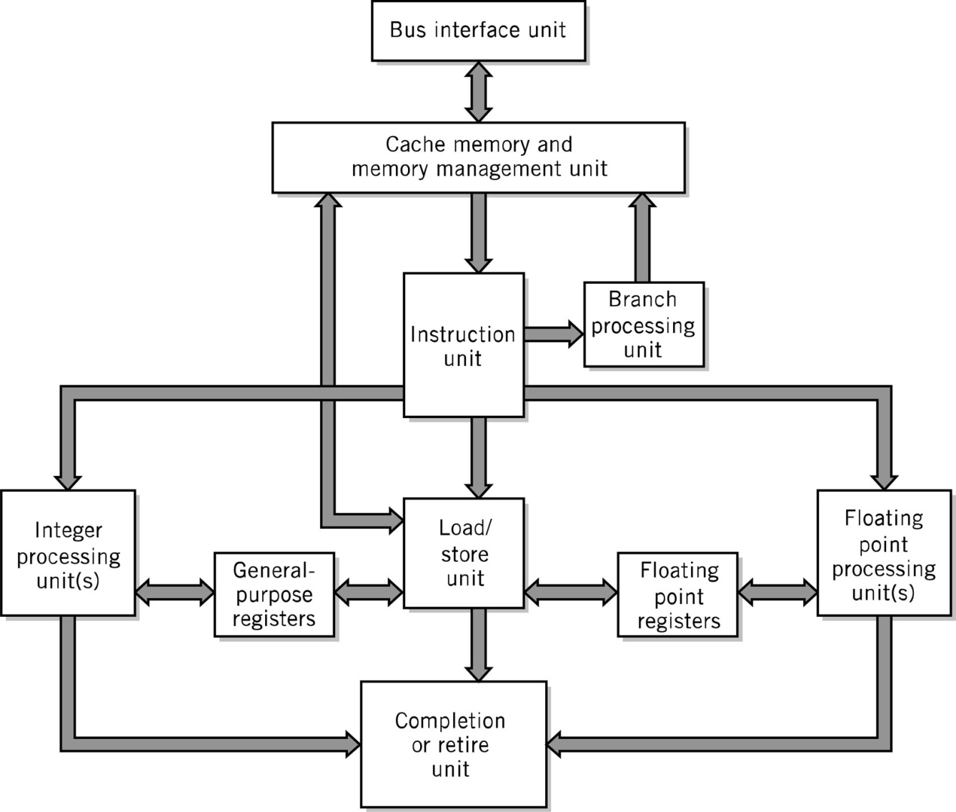
Superscalar CPU Block Diagram
Copyright 2010 John Wiley & Sons, Inc.
8-<number>

Slide 19
Superscalar Processing
Process more than one instruction per clock cycle
Separate fetch and execute cycles as much as possible
Buffers for fetch and decode phases
Parallel execution units
Copyright 2010 John Wiley & Sons, Inc.
8-<number>

Slide 20
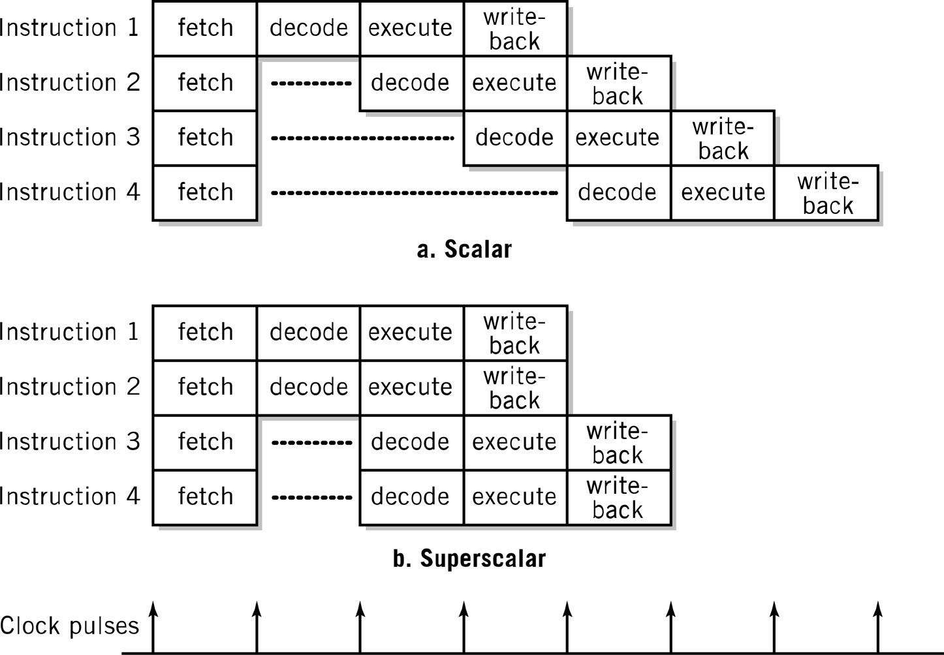
Scalar vs. Superscalar Processing
In superscalar, multiple execution units permit simultaneous execution of several instructions
Copyright 2010 John Wiley & Sons, Inc.
8-<number>

Slide 21
Improving performance
Superpipelining
  Using more than four stages to complete an instruction
  Older Intel Pentium chips use pipeline with 12-stage instructions
  Newer Pentium chips uses pipeline with 20-stage machine cycle
© 2005 Pearson Addison-Wesley. All rights reserved

Slide 22
Hyperthreading
Speed disparity between the CPU and memory
    Wait states
CPU is underutilized
Executing several independent tasks (not instructions) in parallel
Intel Pentium operating at 3.06 GHz yields 25% performance gains
  Programs must be written specifically to take advantage of hyperthreading
  Few such programs exist today
© 2005 Pearson Addison-Wesley. All rights reserved

Slide 23
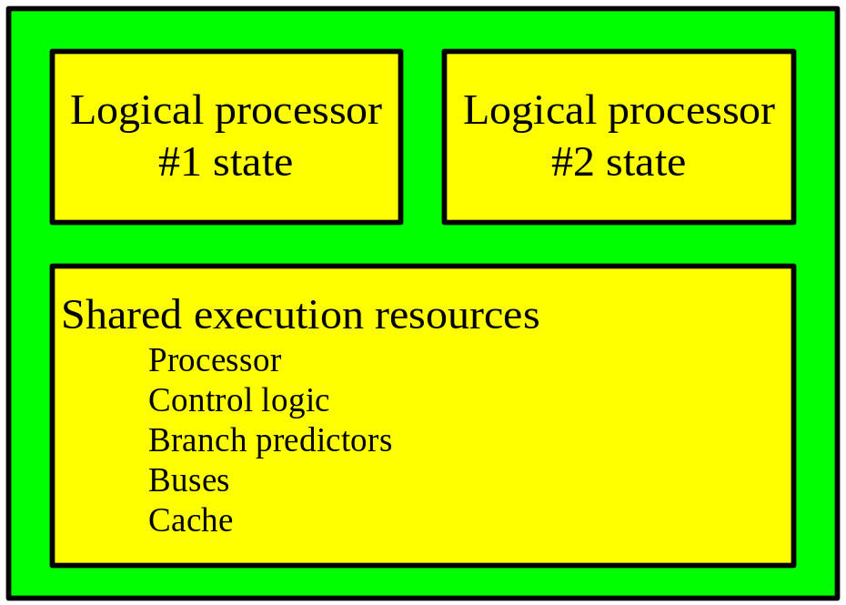
Hyperthreading presents the operating system with two logical processors.
The system maintains copies of both logical processors’ states (the contents of registers)
Logical processors share the physical execution resources.
© 2005 Pearson Addison-Wesley. All rights reserved

Slide 24
Branch Prediction - Solutions
Branch instruction
  Causes a break in the sequential execution of instructions
  A jump to a different instruction
  Examples: branch, jump, procedure call, return, interrupts
Branch prediction
  Pre-fetch the target instruction before it is needed
  Intelligent processors use probabilistic algorithms that can predict one or more branches ahead of time based on the history of execution of the same instruction
    Intel Pentium processors
Separate pipelines for both possibilities
  Conditional branch taken
  Conditional branch not taken
© 2005 Pearson Addison-Wesley. All rights reserved

Slide 25
Out-of-Order Instruction Execution
Sequential execution of instructions
Out-of-order execution possible if there are no dependencies between instructions
© 2005 Pearson Addison-Wesley. All rights reserved

Slide 26
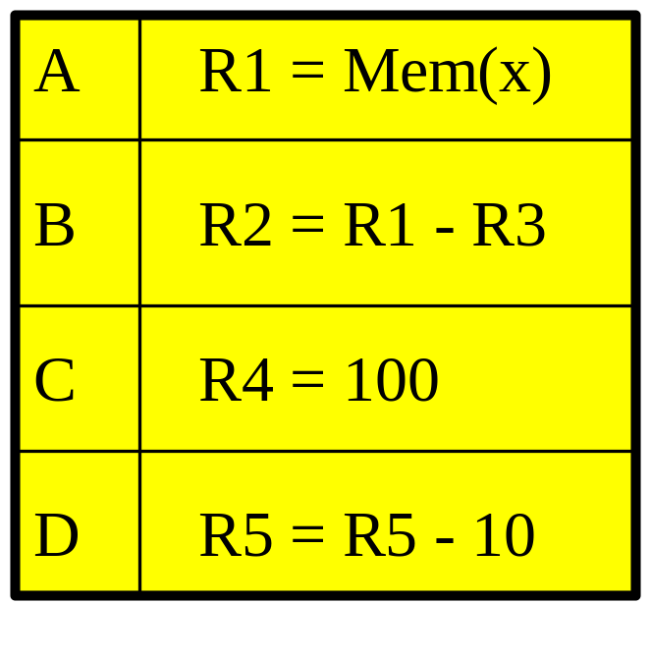
Out-of-order instruction execution
Normally 4 machine cycles needed
A and B must execute sequentially
C, D independent, can execute in any order
A, C, and D can execute in parallel during 1st clock cycle
B (depends on A) is executed during 2nd cycle
Result: two cycles
© 2005 Pearson Addison-Wesley. All rights reserved

Slide 27
Memory Enhancements
Memory is slow compared to CPU processing speeds!
  2GHz CPU = 1 cycle in ½ of a billionth of a second
  70ns DRAM = 1 access in 70 millionth of a second
Cache Memory
(SRAM)
Main
Memory
(DRAM)
CPU
Registers
0.5 ns 3-10 ns 10-50 ns
64- or 128-bit 512KB-1MB 2GB
Copyright 2010 John Wiley & Sons, Inc.
8-<number>

Slide 28
Memory Enhancements
Methods for improvement memory accesses
  Wide Path Memory Access
    Retrieve multiple bytes (8 or 16) instead of 1 byte at a time
    Achieved by widening the bus data path and using a larger MDR – more instructions/data could be fetched and stored in a buffer for execution
  Memory Interleaving
    Partition memory into subsections, each with its own address register and data register
    Access independently more than one location at a time
    A 2-way interleaving makes possible to access an odd memory address and even memory address concurrently
  Cache Memory
Copyright 2010 John Wiley & Sons, Inc.
8-<number>

Slide 29
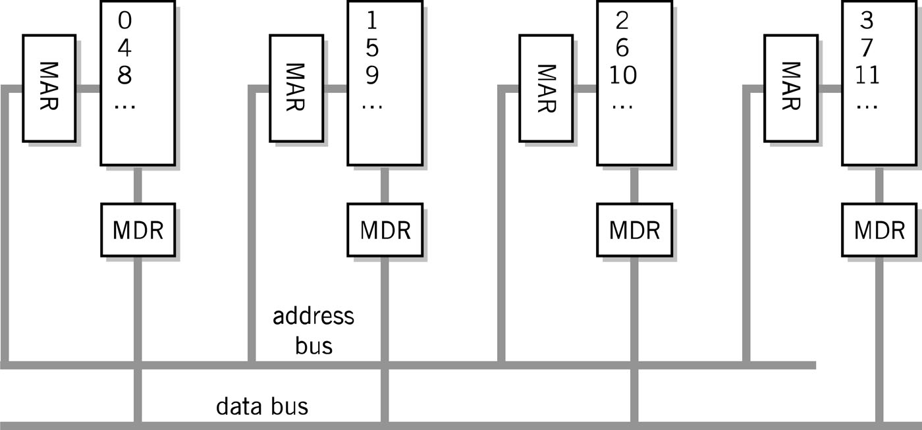
Memory Interleaving
Copyright 2010 John Wiley & Sons, Inc.
8-<number>

Slide 30
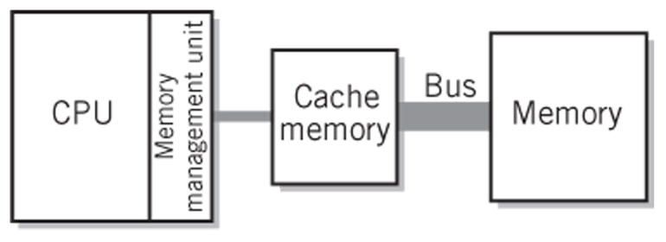
Cache Memory
Implemented in SRAM chips, more expensive
On the CPU chip, built-in
High-speed memory
  Speed improved by about 3 times compared to conventional memory DRAM
Size
  Level 1 – data cache and instruction cache, 64 KB each
  Level 2 - 512 KB or 1 MB
Organized in blocks (of the size 8 bytes or 16 bytes), differently than regular memory
  A block holds an exact reproduction of a corresponding amount of storage from somewhere in main memory
Copyright 2010 John Wiley & Sons, Inc.
8-<number>

Slide 31
Cache Memory
Each block has a tag
  The tag identifies the location in main memory that corresponds to the data being held in that block.
Cache controller
  hardware that checks tags
Cache Line
  Unit of transfer between storage and cache memory
When cache memory is full, some block in cache memory must be selected for replacement
  LRU - Least Recently Used Algorithm
Copyright 2010 John Wiley & Sons, Inc.
8-<number>

Slide 32
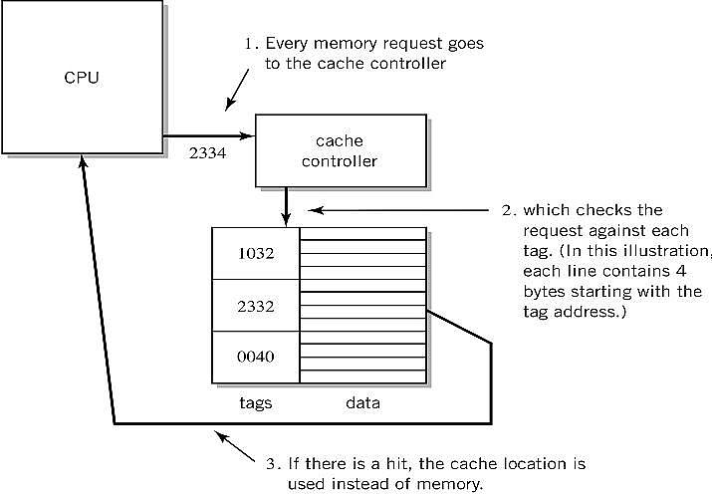
Step-by-Step Use of Cache
Copyright 2010 John Wiley & Sons, Inc.
8-<number>

Slide 33
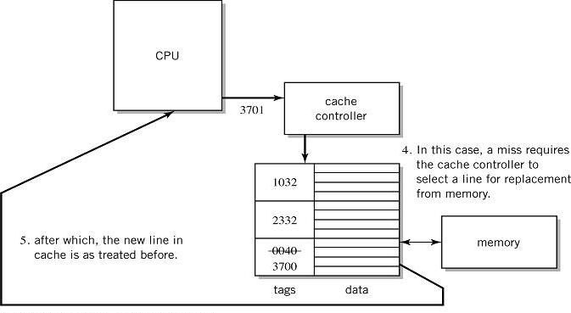
Step-by-Step Use of Cache
Copyright 2010 John Wiley & Sons, Inc.
8-<number>

Slide 34
Performance Advantages
Hit ratios of 90% common
50%+ improved execution speed
Locality of reference is why caching works
  Most memory references confined to small region of memory at any given time
  Well-written program is small loop, procedure or function
    This is how we are taught to write computer programs
  Data likely in array
  Variables stored together
Copyright 2010 John Wiley & Sons, Inc.
8-<number>

Slide 35
Memory requests
Impose a burden on cache memory operations, since data must also be written to the main memory to protect the integrity of the program and its data
Two write methods
  write through - writes data back to main memory immediately upon change in cache
  advantage: the contents of cache and conventional memory is identical
  write back - writes to memory are made only when a cache line is actually replaced
  Advantage: speed
To be effective, cache operations must be completely controlled by hardware
Copyright 2010 John Wiley & Sons, Inc.
8-<number>

Slide 36
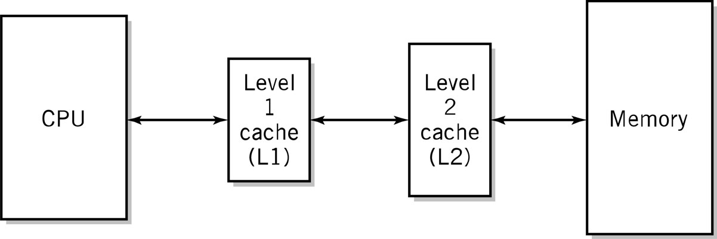
Two-level Caches
Why do the sizes of the caches have to be different?
Two integrated, but distinct caches: L1 and L2. The AMD Athlon 64 processor provides 64KB of L1 data cache and 64KB of L1 instruction cache; and 512 KB or 1MB level 2 cache within the same package as the CPU.
Copyright 2010 John Wiley & Sons, Inc.
8-<number>

Slide 37
Disk cache
Part of main memory is allocated for use as a disk cache to minimize the number of disk accesses
Access time to disk is measured in ms
  Compare it to access time to memory or registers measured in ns
Copyright 2010 John Wiley & Sons, Inc.
8-<number>

Slide 38
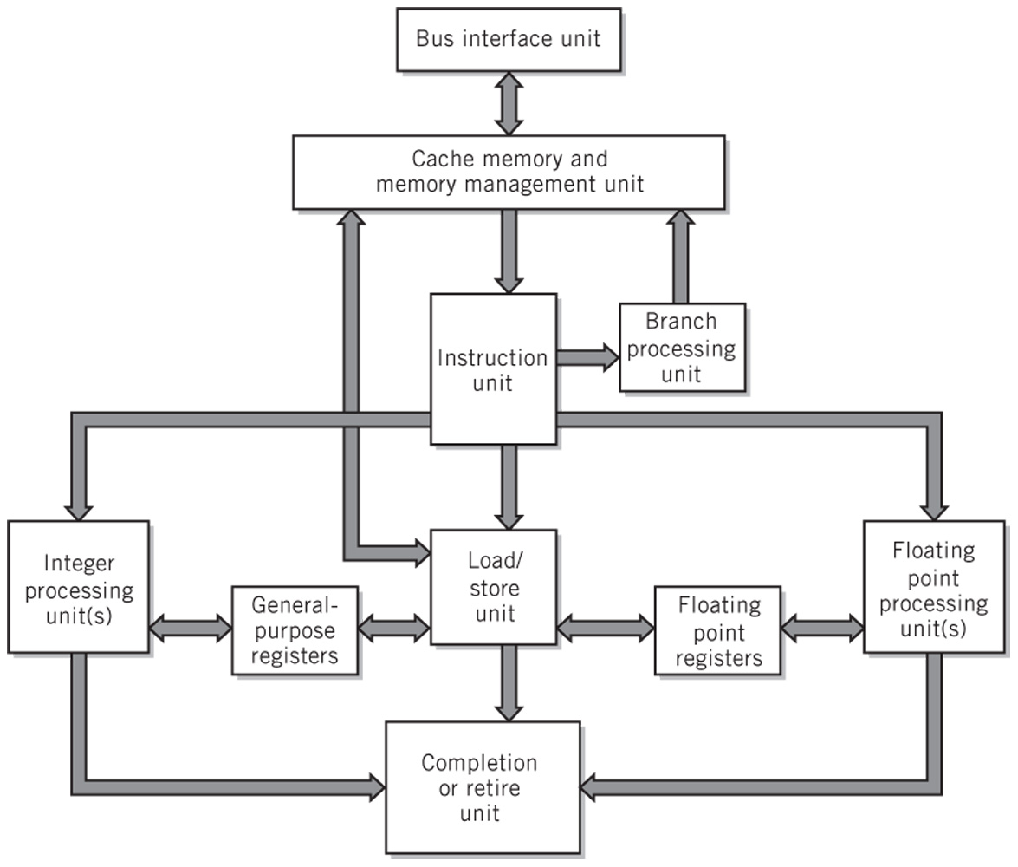
Modern CPU Block Diagram
Copyright 2010 John Wiley & Sons, Inc.
8-<number>

Slide 39
Multiprocessing
Reasons
  Increase the processing power of a system
  Parallel processing
  Increase relaibility
Multiprocessor system
  Tightly-coupled system
  Multicore processors - when CPUs are on a single integrated circuit
Copyright 2010 John Wiley & Sons, Inc.
8-<number>
Notes:
Heart pace maker. Life and death value. It contains 2 or 3 CPU executing the same program independently. If one fails, another picks up slack. If a failure rate of one CPU is 0.01 (1%), say hypothetically, the probability that all 3 CPUs fail at the same time is 0.01*0.01*0.01=0.000001.

Slide 40
Multiprocessor Systems
Identical access to programs, data, shared memory, I/O, etc.
Easily extends multi-tasking, and redundant program execution
Two ways to configure
  Master-slave multiprocessing
  Symmetrical multiprocessing (SMP)
Copyright 2010 John Wiley & Sons, Inc.
8-<number>

Slide 41
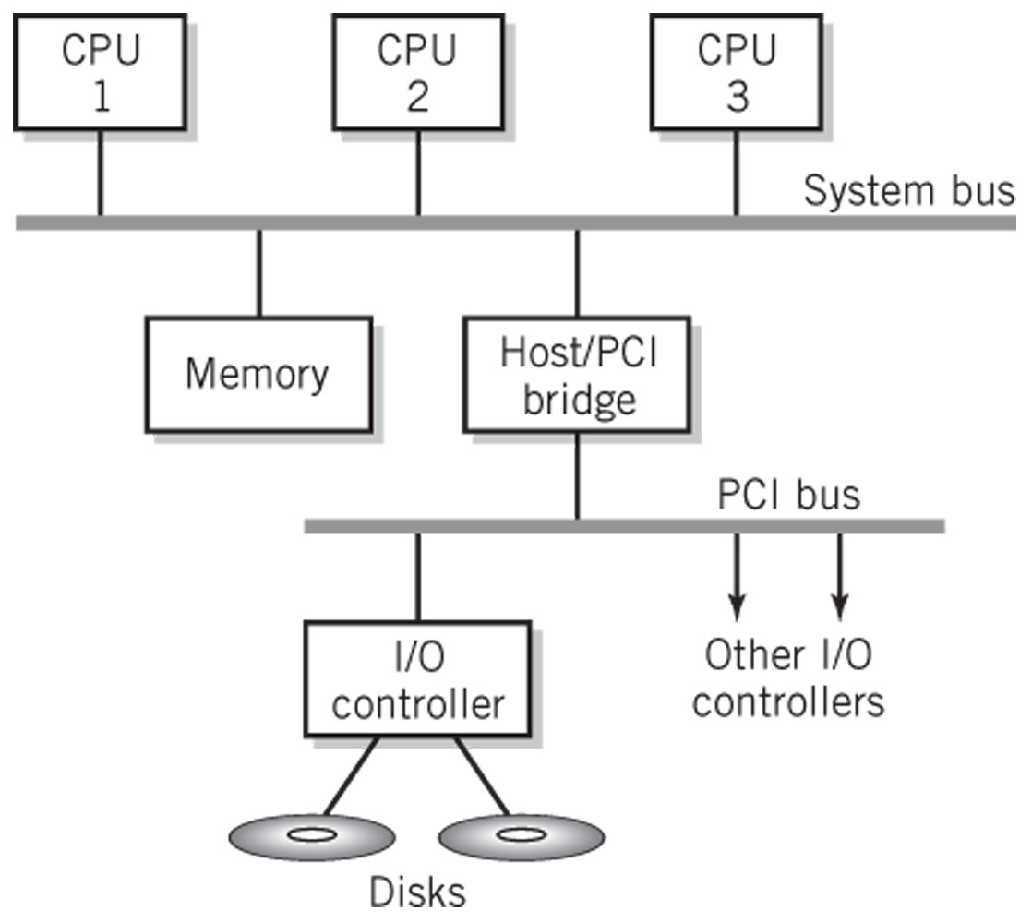
Typical Multiprocessing System Configuration
Copyright 2010 John Wiley & Sons, Inc.
8-<number>

Slide 42
Master-Slave Multiprocessing
Master CPU
  Manages the system
  Controls all resources and scheduling
  Assigns tasks to slave CPUs
Advantages
  Simplicity
  Protection of system and data
Disadvantages
  Master CPU becomes a bottleneck
  Reliability issues – if master CPU fails entire system fails
Copyright 2010 John Wiley & Sons, Inc.
8-<number>

Slide 43
Symmetrical Multiprocessing
Each CPU has equal access to resources
Each CPU determines what to run using a standard algorithm
Disadvantages
  Resource conflicts – memory, i/o, etc.
  Complex implementation
Advantages
  High reliability
  Fault tolerant support is straightforward
  Balanced workload
Copyright 2010 John Wiley & Sons, Inc.
8-<number>

